Slide 1
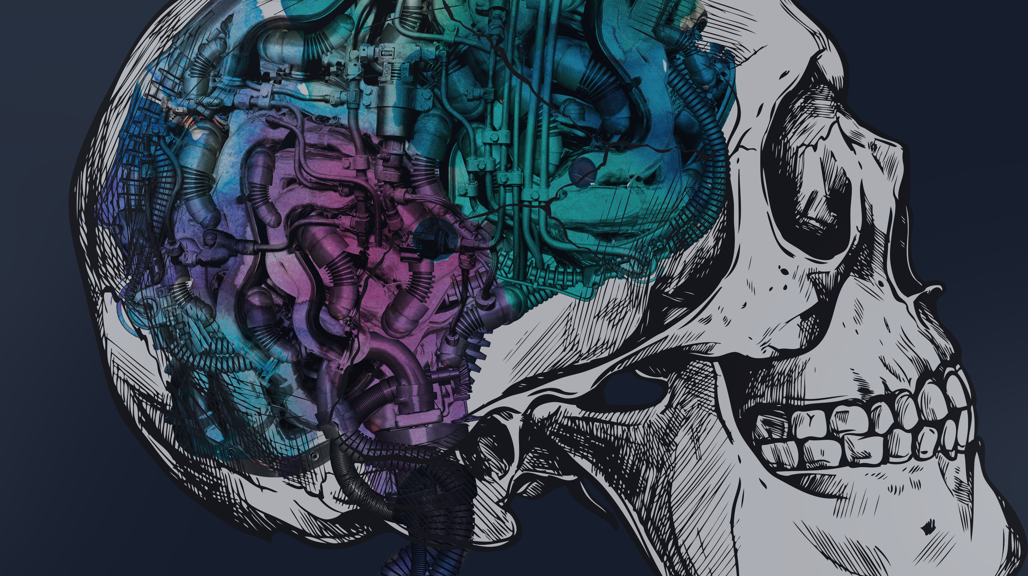
In this session we will look to understand what a Data scientist does well and what they do badly
Machine Learning: From model to production using the cloud, Containers and DevOps
We will explore the history of DevOps. We will look at the core components and how they relate to machine learning.
We will learn then look at how we can hook this all together with a demo of Azure DevOps, Python, Docker and Kubernetes

Slide 2
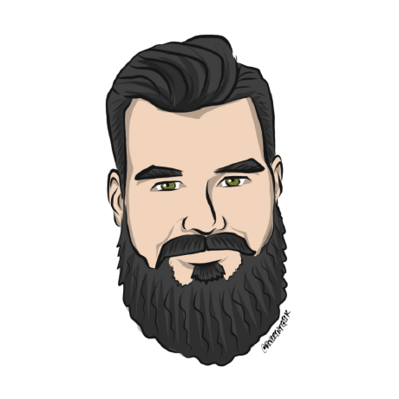
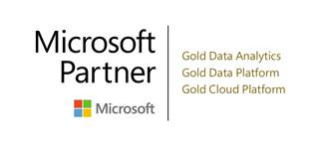

Machine Learning: From Model to Production
Using the cloud, Containers and DevOps
Terry McCann | @SQLShark

Slide 3
Introductions
2. Machine Learning
3. Creating a Model in Python
4. What is DevOps
5. Docker and Docker-Compose
6. Kubernetes and Helm
7. Azure DevOps
8. Rendezvous Architecture
9. Close day. Grab a beer

Slide 4

Terry McCann
Head of Data Science for Adatis.
Microsoft Most Valuable Professional (MVP)
11+ Years working with data and engineering
MSc in Data Science from Dundee
I live in Devon with my Wife and little boy Dusty
I love board games.

Slide 5
Over to You.

Slide 6


Where to find the slides and demos
https://github.com/SQLShark
Terry McCann 2018
Notes:
• How to Use the WHERE Clause
• Overview of Operators
• Filter Data by Using Comparison Operators
• Filter Data by Using String Comparisons
• Filter Data by Using Logical Operators
• Filter Data Using a Range of Values
• Filter Data Using a List of Values
• Working with NULL Values
• Introducing Native SQL Server Functions
• Functions Relating to NULL Values

Slide 7


Questions?
Shout them out!!

Slide 8
Who is a Software developer?

